Slide 1

MAJOR PROJECT REVIEW - 3
Smart Explainable AI Model for Personalized Disease Risk Assessment and Early Disease Prediction
Name : Hemanth Kumar Pattem (Reg. No. 24691F0071)
Project Guide : Dr. SRINIVASAN JAGANNATHAN, M.C.A., Ph.D.,

Slide 2


Agenda
Title
Abstract
Technologies and Tools Used
Modules Description
Testing
Experimental Results
Performance Evaluation
Comparison with Existing System
Code Snippets
Screenshots of Implementation
Conclusion
Scope for Future Enhancement

Slide 3
Abstract
This work presents a Smart Explainable AI Framework for early disease prediction and personalized healthcare risk assessment. The system predicts Diabetes, Heart Disease, and Breast Cancer using a hybrid ensemble model with Random Forest, XGBoost, and Logistic Regression. SHAP and LIME are integrated to provide explainable and transparent predictions. The framework identifies important risk factors such as glucose, BMI, age, and tumor features, supporting accurate prediction, preventive healthcare, and better clinical decision-making.

Slide 4
Technologies and Tools Used
Programming Language- Python
Libraries and Frameworks
Pandas
NumPy
Scikit-learn
TensorFlow / Keras
Matplotlib
Seaborn
Explainable AI Tools
SHAP
LIME
Development Environment
Jupyter Notebook
Google Colab
Datasets Used
PIMA Indians Diabetes Dataset
UCI Heart Disease Dataset
Breast Cancer Wisconsin Dataset

Slide 5
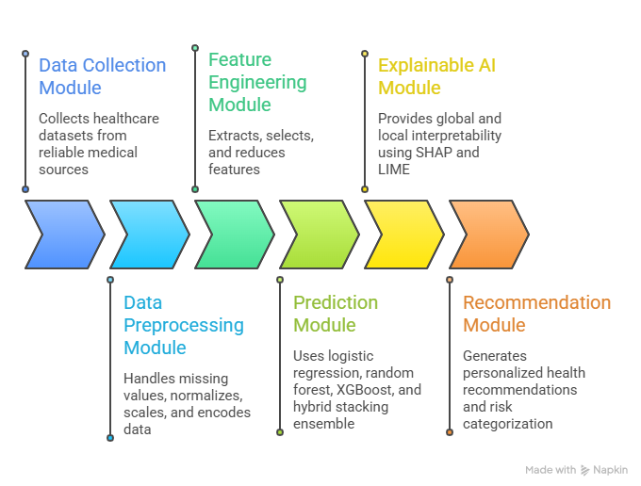
Modules Description

Slide 6
Testing
Black Box Testing
Tested system functionality without viewing internal code.
Verified:
Correct disease prediction
Risk score generation
Recommendation output
White Box Testing
Tested internal program logic and workflows.
Verified:
Data preprocessing flow
Feature selection process
Model integration
Unit Testing
Tested each module independently.
Modules tested:
Dataset loading
Scaling functions
Model prediction functions
SHAP & LIME explanation modules

Slide 7
Experimental Results
ROC-AUC Scores of Individual Models
Disease | Logistic Regression | Random Forest | XGBoost
Diabetes | 0.8226 | 0.8370 | 0.8257
Heart Disease | 0.9213 | 0.9316 | 0.9203
Cancer | 0.9928 | 0.9972 | 0.9951

Slide 8
Experimental Results
Comparison Of Best Individual Model Vs. Ensemble Model Performance Across Diseases
Disease | Best Individual AUC | Ensemble AUC | Improvement (%)
Diabetes | 0.8370 | 0.8207 | -1.95%
Heart Disease | 0.9316 | 0.9364 | +0.52%
Cancer | 0.9972 | 0.9971 | -0.02%

Slide 9
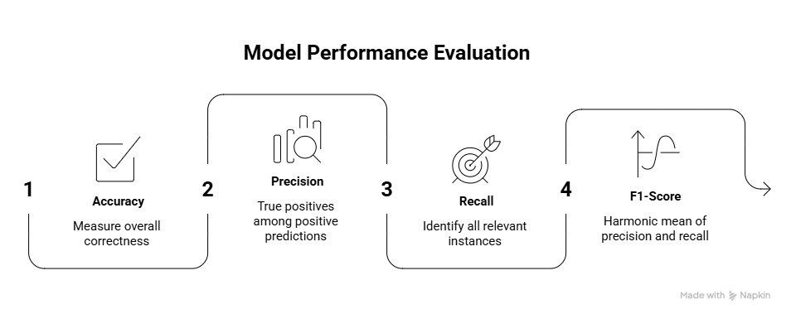
Performance Evaluation

Slide 10
Comparison with the Existing System
Aspect | Existing System | Proposed System
Disease Prediction | Predicts one disease at a time | Predicts multiple diseases in one framework
Data Scope | Uses only clinical data | Uses clinical, lifestyle, and demographic data
Model Approach | Uses single ML models | Uses hybrid ensemble models
Explainability | No explanation for predictions | Uses SHAP/LIME for explanations
Output | Gives Yes/No result | Gives risk score and recommendations
Usability | Limited real-world use | Personalized and healthcare-friendly

Slide 11
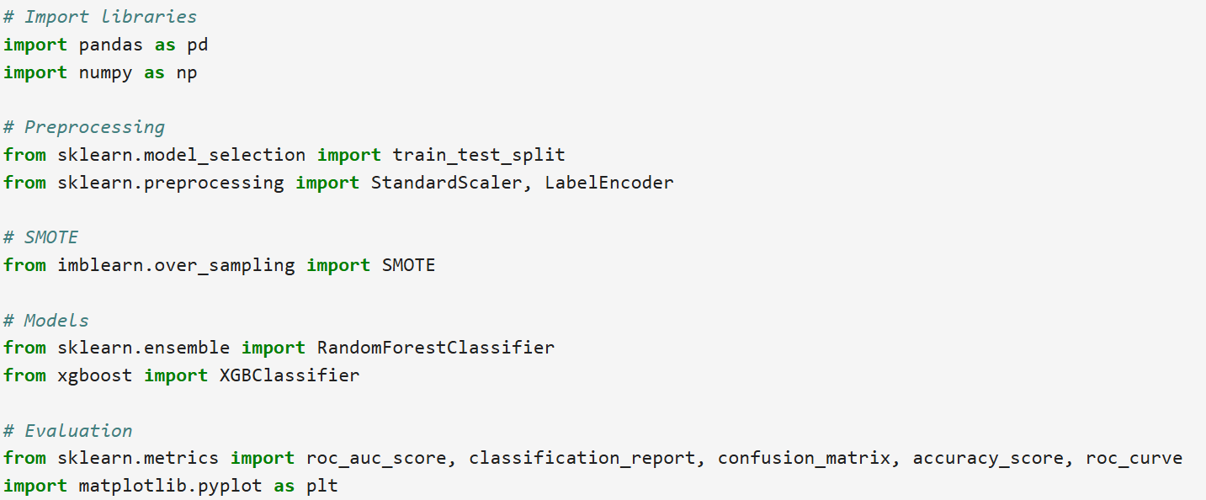
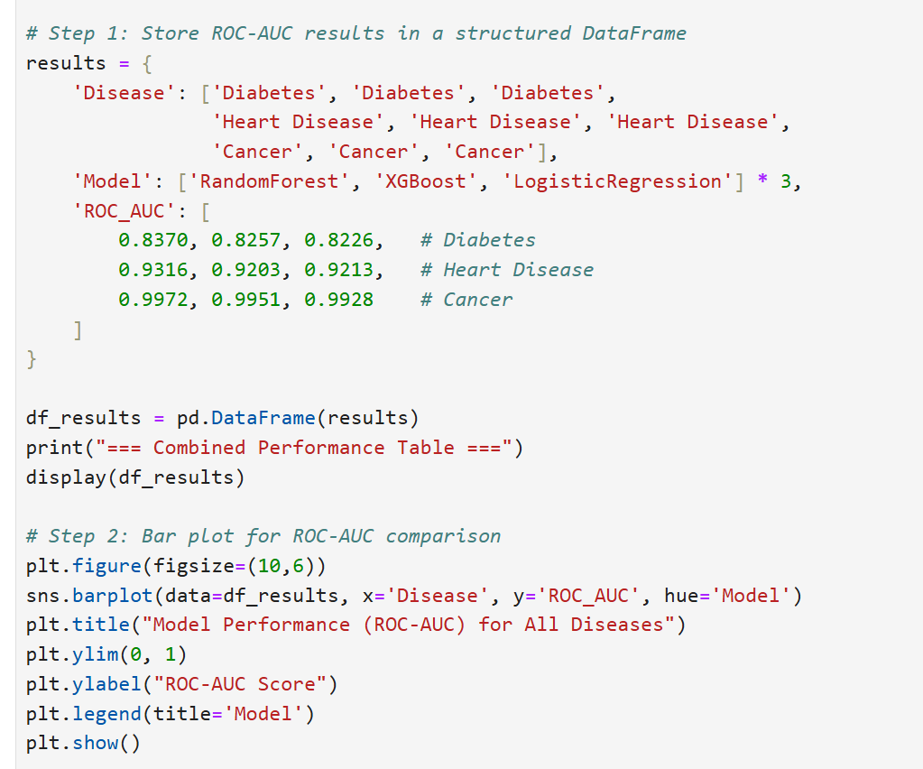
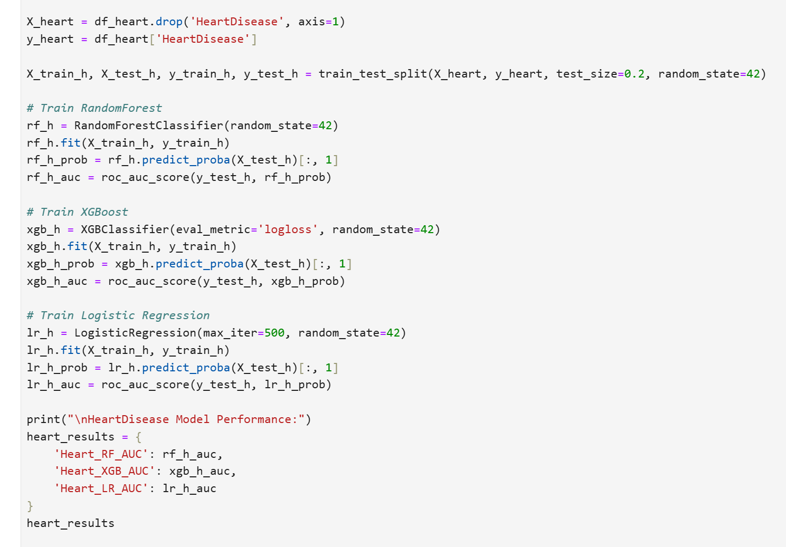
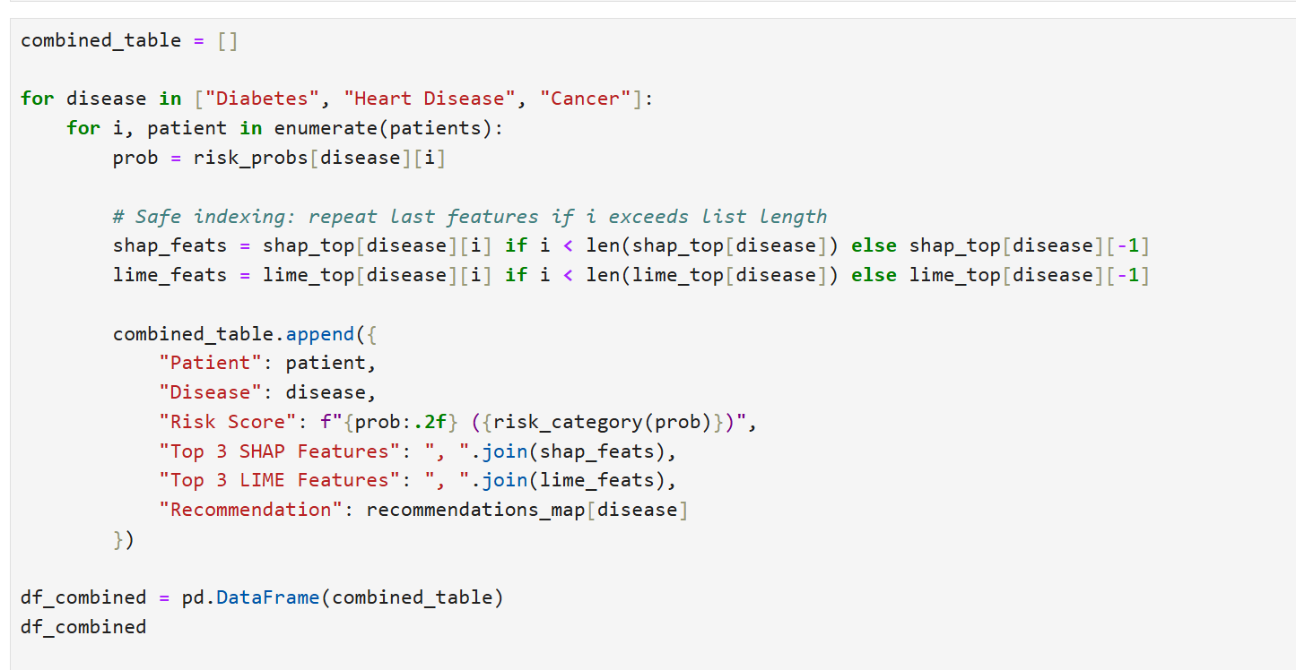
Code Snippets

Slide 12
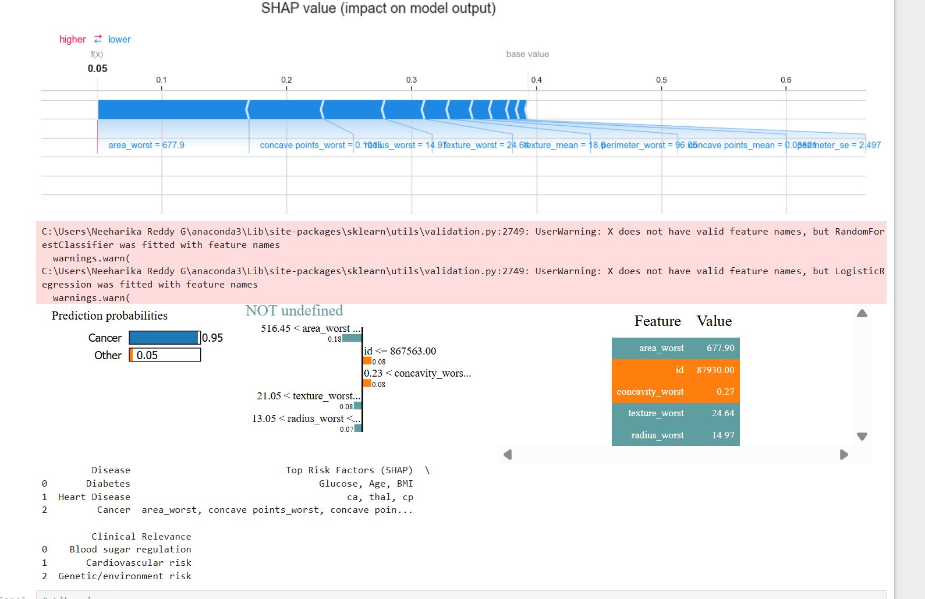
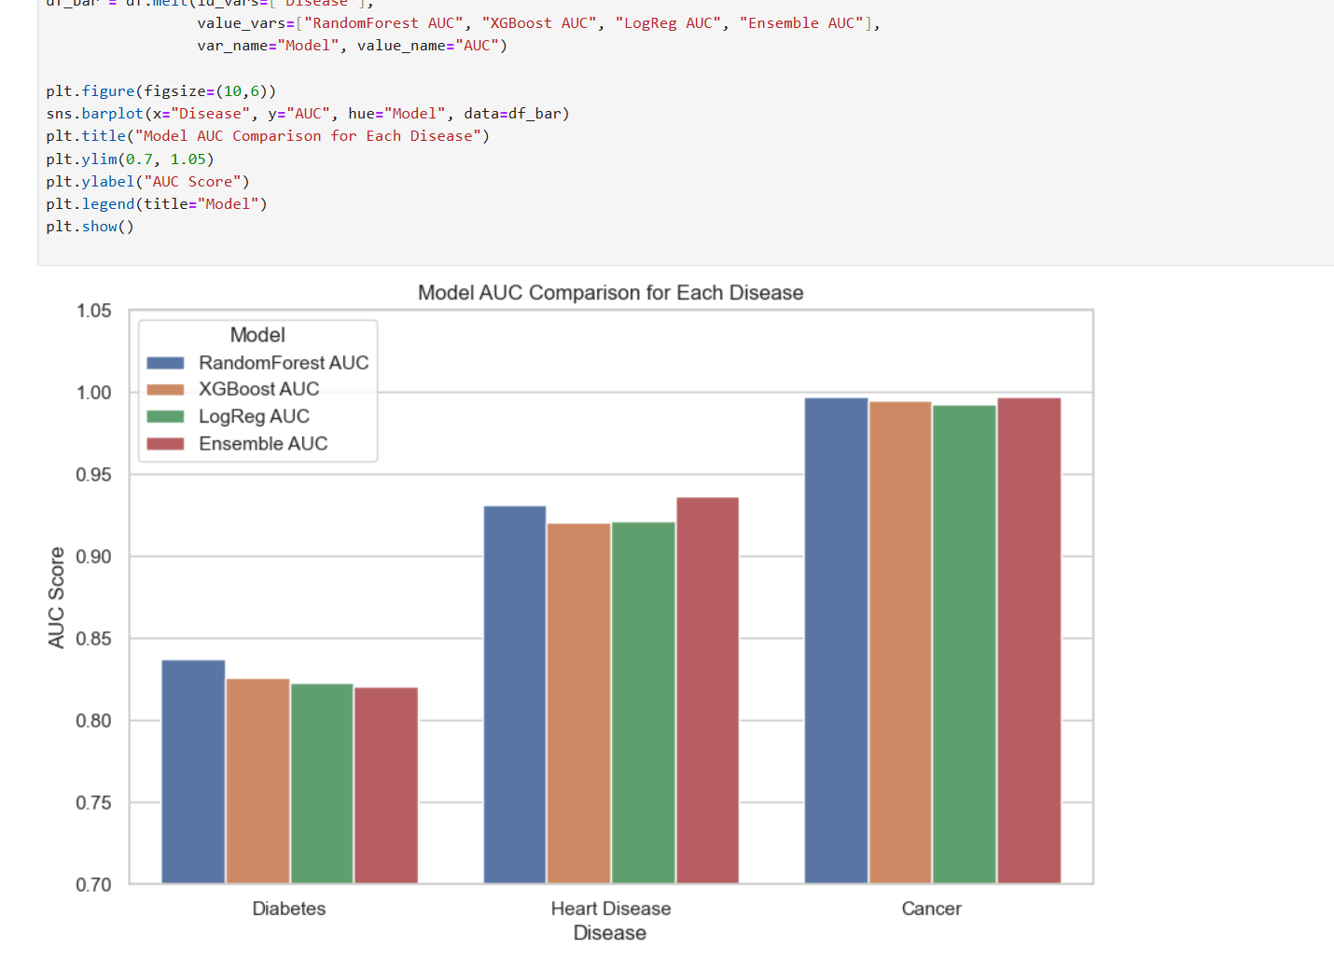
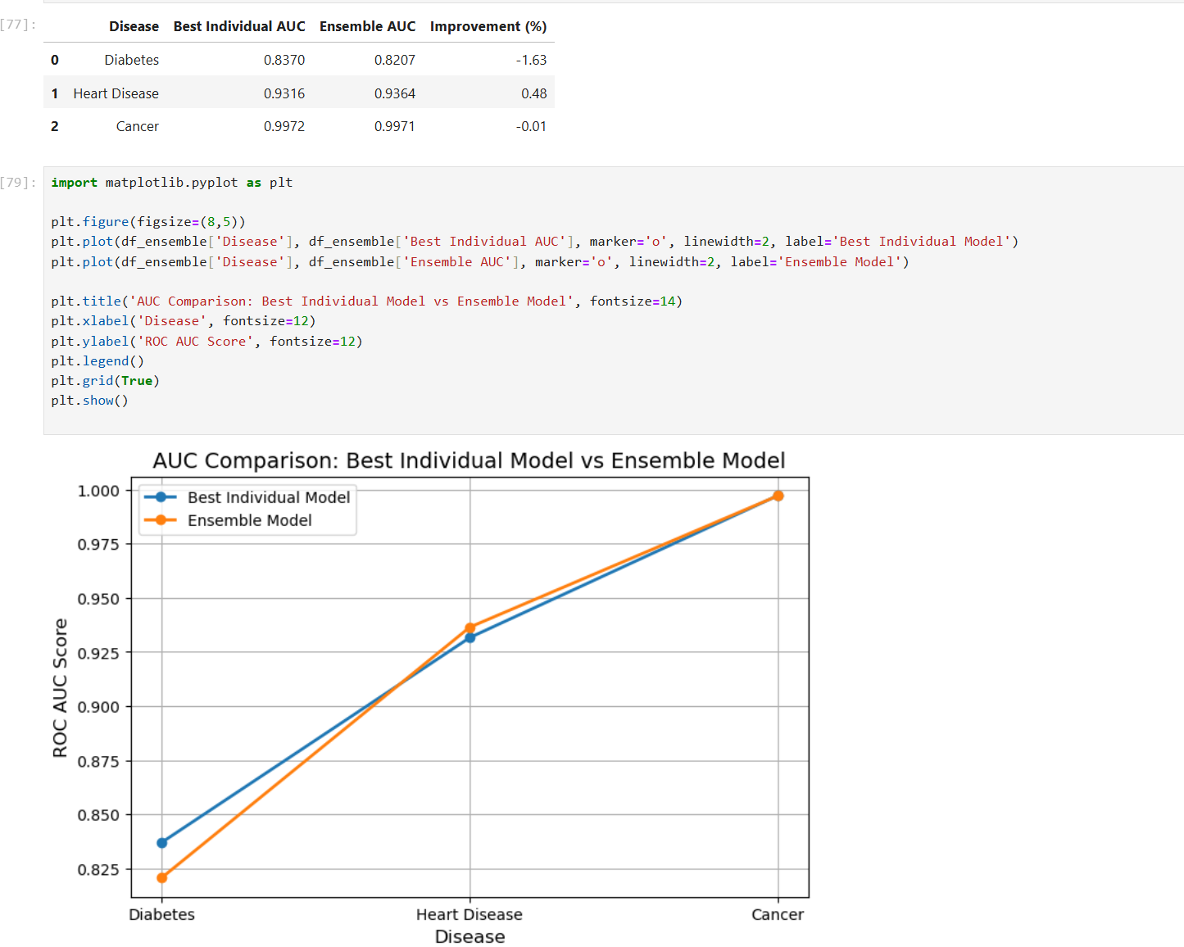
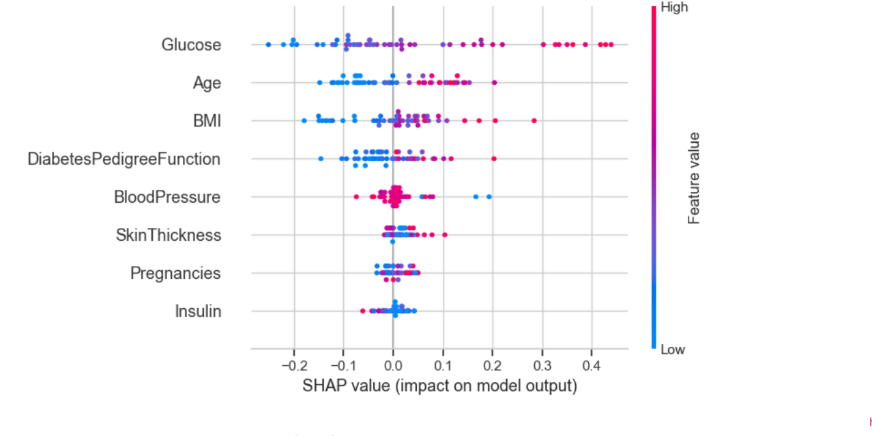
Screenshots of Implementation

Slide 13
Conclusion
Developed a Smart Explainable AI Framework for multi-disease prediction.
Used Random Forest, XGBoost, and Logistic Regression in a hybrid ensemble model.
SHAP and LIME improved transparency and interpretability.
Successfully predicted:
Diabetes
Heart Disease
Breast Cancer
Provided personalized healthcare recommendations.
Supports early disease detection and preventive healthcare.

Slide 14
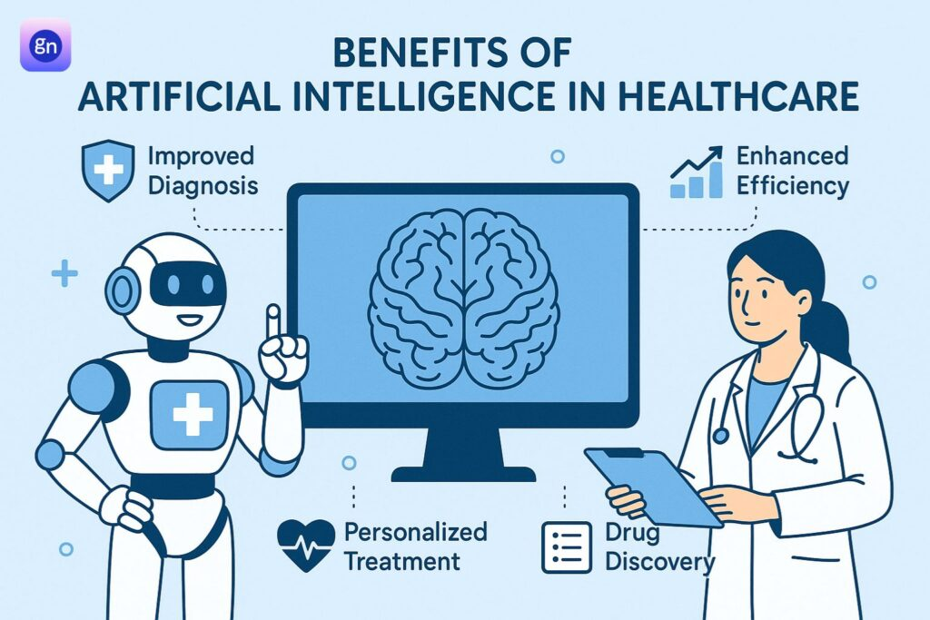
Scope for Future Enhancement
Integration with wearable devices
Real-time health monitoring
Addition of more diseases
Integration with hospital EHR systems
Mobile healthcare application

Slide 15
Thank You

